Slide 1
NFT Rating

Slide 2
NFT – Non-fungible token. what is it?!
A non-fungible token is a unique and non-interchangeable unit of data stored on a digital ledger (blockchain). NFTs can be associated with reproducible items such as photos, videos, 3D models, audio, and other types of digital files as unique items(analogous to a certificate of authenticity). Wikipedia
NFTs can also be used to define the ownership of a physical product by creating a digital copy of physical product (Digital Twins). NFTs use blockchain technology to provide a public proof of ownership. Copies of the original file are not restricted to the owner of the NFT, and can be copied and shared like any file. The lack of interchangeability (fungibility) distinguishes NFTs from blockchain cryptocurrencies, such as Bitcoin. Wikipedia
Examples of NFT items: first tweet, NBA Top Shots, house in Kiev, YouTube video clip, cartoon picture of rocks, Gourmet NFTs (professional and home chefs food recipes), digital art that no one will ever see, digital fragrance, NFT tree and many others.
The crypto world is fast-moving. By the time you’re reading this, there’s probably new crazy NFTs project is upcoming. Between working with the NFT industry and spending hours and hours researching NFTs, it's clear to us that the potential of NFTs is near-limitless. If the next five years are anything like 2021, we’re going to see blockchain technology and NFTs disrupt all types of industries. And we’ll see demand for NFTs continue to rise. But with the rising popularity of NFTs, it's more difficult than ever to find interest NFTs with potential growth. Many of NFT ideas/projects broke new ground in the NFT space and cultivated excitement and hype around their releases.

Slide 3
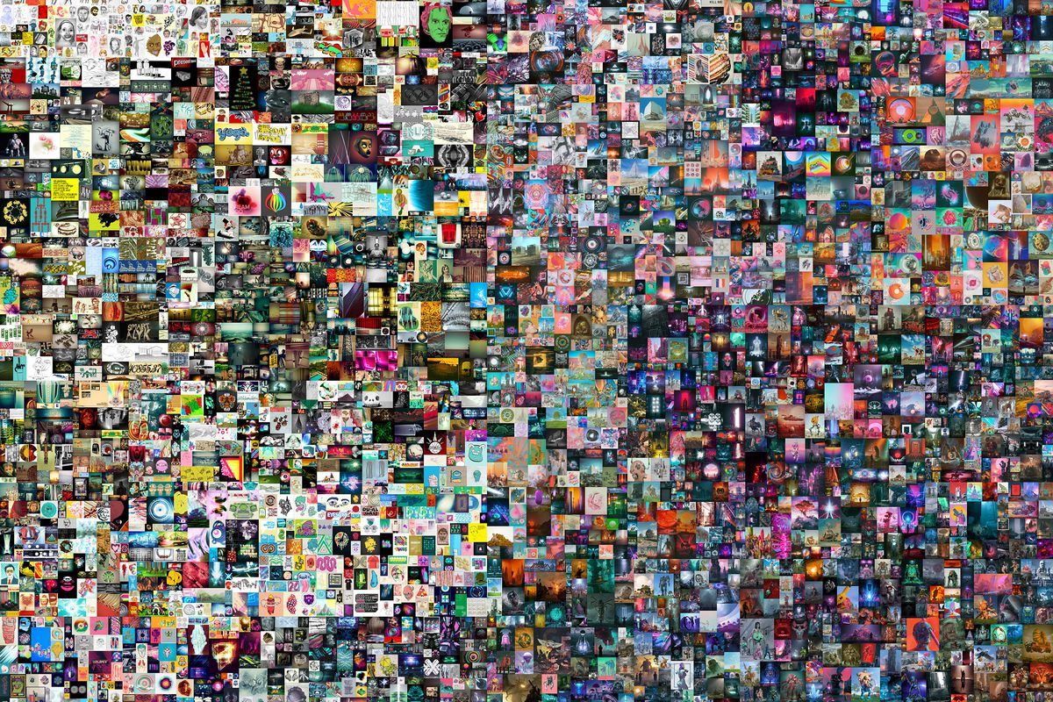
Why rating is needed?
Creator – Beeple
"Everydays - The First 5000 Days”
Until October 2020, the most Mike Winkelmann — the digital artist known as Beeple — had ever sold a print for was $100.
At Mar 11 2021 Everydays was sold for $69 million
*For now it’s the most expensive NFT

Slide 4
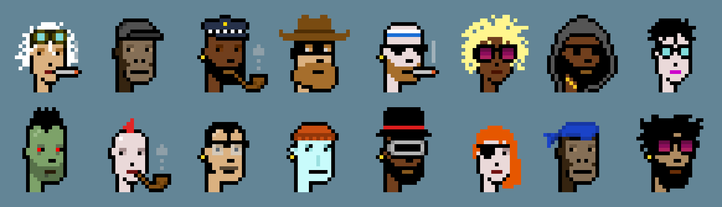
Why rating is needed?
The CryptoPunks are 10,000 uniquely generated characters.
Original mint price about 150-250$.
Current Lowest Price Punk Available 68 ETH ($271,519.24 USD)
Number of Sales (Last 12 Months) 12,005
Total Value of All Sales (Lifetime) 613.53KΞ ($1.78B)
Value of Sales (24 Hours) 1.76KΞ ($7.08M)
Value of Sales (Week) 12.34KΞ ($51.26M)
Value of Sales (4 Weeks) 34.61KΞ ($149.28M)

Slide 5


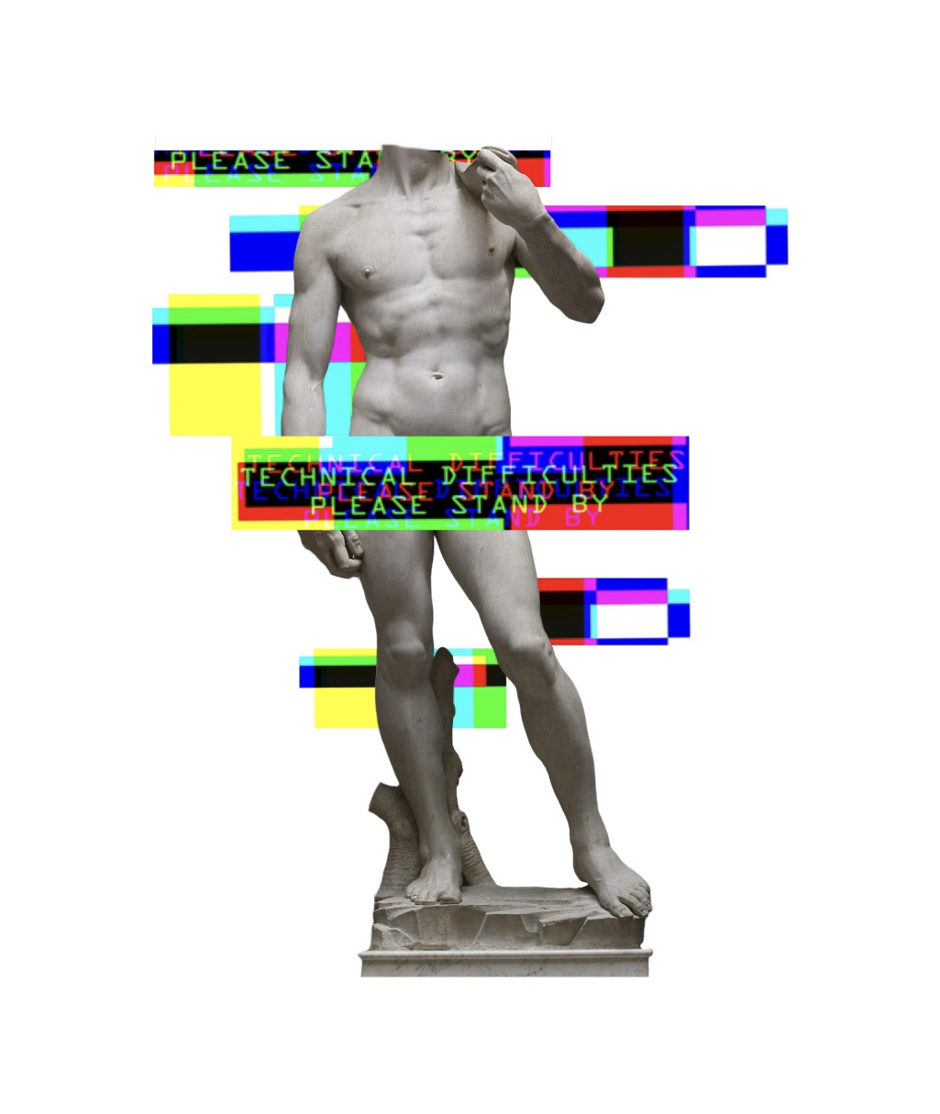
Why rating is needed?
New projects for sale now
$10
$20
$200

Slide 6
NFT Rating project – main purpose and logic
Main purpose – to analyse NFT upcoming/young projects data and to predict potential growth
Rating logic - NFT rating process based on few basic sources - NFT project official sites, NFT community platforms/sites, NFT marketplaces, social media, messaging and digital distribution platform.
Twitter - good promise projects has large and most important active/dynamic twitter. The things that should be examined:
Project registration date on twitter
Quantity of new twits
Project followers on twitter - if there are other popular NFT projects, the project can be promoted by them.
If project exists on twitter for few months without any significant progress, most of chances that it won't be successful
Additional functionality (except NFT) - stacking, gaming, any other relatively complex functionality.
Twitter pages of other collectors and influencers, should be scanned for mentioning the project.
Discord - Peoples activity, project events, competitions and contests. How project works with community/people.
Project site – Roadmap, final goal of a project should NOT be NFT - game, series, performance or something else

Slide 7
NFT Rating project – technical details
Project language - python
Data Sources:
Projects – rarity.tools and opensea.io
Projects public activity – tweeter and discord
Roadmap - project site
Tools and technologies:
Server – Google Cloud Platform
Code version management - GIT
Data gathering – REST API, Web scraping (selenium)
Data storage – BigQuery and MySQL
Data processing – Spark, kafka
Scheduling – Airflow
Natural language analyzing - Cloud Natural Language API

Slide 8
NFT Rating project – architecture diagram

Slide 9
project Steps – new/upcoming projects data gathering
rarity.tools -Web scraping (selenium) and opensea.io - REST API

Slide 10
project Steps – twitter users data enrichment
Twitter Developer Platform – users/show endpoint

Slide 11
project Steps – twitter statuses data gathering
Twitter Developer Platform – statuses/user_timeline endpoint

Slide 12
project Steps – tweets data gathering
Twitter Developer Platform – search/tweets endpoint

Slide 13

project Steps – Project rating calculation
Spark – pulling data from BigQuery + Rating calculation.
Calculation results stored in MySQL database.

